Slide 1


HITECH and HIPAA Privacy and Security Training
SDM COMPLIANCE HOTLINE: 844-248-9266
Reviewed by: Gunther Kohn
Chief Information Officer, UB School of Dental Medicine
Date: October 20, 2015
Approved by: Sarah L. Augustynek
Compliance Officer, UB School of Dental Medicine
Date: October 20, 2015

Slide 2


SDM HIPAA PRIVACY & SECURITY OFFICERS:
SDM HIPAA Privacy Officer:
Sarah L. Augustynek, JD/MPH, SDM Compliance Officer
716-829-3332
slcouch@buffalo.edu
SDM HIPAA Security Officer:
Gunther Kohn, CIO
716-829-2057
gkohn@buffalo.edu
Notes:
SDM: Security Officer- Gunther Kohn, CIO, in conjunction with GK

Slide 3

HIPAA-HITECH TRAINING
HIPAA Objectives:
To protect the privacy and security of an individual’s Protected Health Information (PHI).
To use the “Minimum Necessary Standard” when using or disclosing PHI is permissible:
Minimum Necessary Standard: When using or disclosing PHI or when requesting health information from another covered entity (CE) or business associate (BA) a CE or BA must make reasonable efforts to limit PHI to the minimum necessary to accomplish the intended purpose of the use, disclosure, or request.
Business Associate (BA) is a person or entity who on behalf of a covered entity/provider:
Receives PHI
Maintains PHI
Transmits PHI
Creates PHI
Limits disclosures to least amount of information required to convey the necessary information.

Slide 4

HIPAA-HITECH TRAINING
The inappropriate review of patient medical information without a direct need for diagnosis, treatment or other lawful use as permitted by statutes or regulations governing the lawful access, use or disclosure of medical information is prohibited.

Slide 5
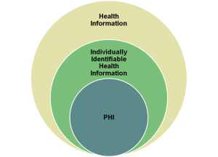
HIPAA-HITECH TRAINING
We must protect an individual’s personal and health information that…
Is created, received, or maintained by the SDM as a covered provider;
Is written, spoken, or electronic;
And, includes at least one of the 18 personal identifiers in association with health information.
Health Information with identifiers =
Protected Health Information (PHI)

Slide 6
HIPAA-HITECH TRAINING
PHI include:
Name
Postal address
Date of birth
All elements of dates except year
Telephone number
Fax number
Email address
URL address
IP address
Social security number
Account numbers
License numbers
Medical record number
Health plan beneficiary #
Medical records
Device identifiers and their serial numbers
Vehicle identifiers and serial number
Biometric identifiers - (finger and voice prints)
Full face photos and other
comparable images
Billing records
Referral authorizations
Any other unique identifying number, code, or characteristic.

Slide 7
HIPAA-HITECH TRAINING
What is the difference between HIPAA Privacy and HIPAA Security?
HIPAA regulations cover both security and privacy of protected health information.
PRIVACY:
The Privacy rule focuses on the right of an individual to control the use of his or her personal information. The Privacy rule covers the confidentiality of PHI in all formats including electronic, paper and oral. The physical security of PHI in all formats is an element of the Privacy rule.
SECURITY
The Security rule focuses on administrative, technical and physical safeguards specifically as they relate to electronic PHI (ePHI).

Slide 8



HIPAA-HITECH TRAINING
We need to protect the entire lifecycle of information
Intake/creation of PHI
Storage of PHI
Destruction of PHI . . .
For any and all formats of PHI

Slide 9
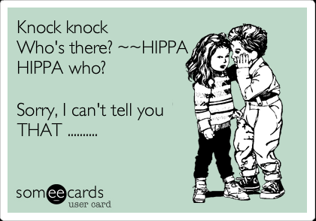
HIPAA-HITECH TRAINING
Good Computing Practices:
Safeguards for Users:
1. Passwords
2. Lock Your Screen
3. Workstation Security
4. Log Off when away
5. Data Management
6. Portable Device Control
7. Computer Security
8. Secure Email Only
9. Safe Internet Use
10. Reporting Security
Incidents / Breach

Slide 10




HIPAA-HITECH TRAINING
Be aware that ePHI is everywhere:
Business and Personal

Slide 11
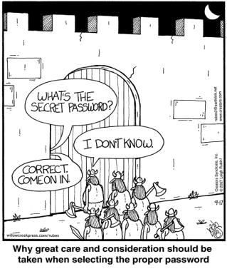
HIPAA-HITECH TRAINING
Use cryptic passwords that can’t be easily guessed and protect your passwords –
Don’t write them down, Don’t share them!
Use 8 Characters –
combination of lower
case and capital letters;
numbers and symbols

Slide 12
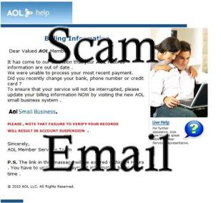
HIPAA-HITECH TRAINING
Practice safe e-mailing
Don’t open, forward, or reply to suspicious
e-mails!!
Don’t open suspicious e-mail attachments or click on unknown website addresses
Delete spam
Do not email patients. SDM e-mails are
not encrypted. Preferred method is fax or
USPS. However if the patient requests
an email with their PHI, it must be
in writing and the patient must be informed
that SDM email is not encrypted.

Slide 13
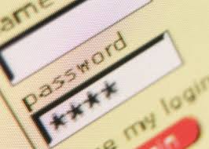
HIPAA-HITECH TRAINING
Practice safe internet use:
Accessing patient information electronically can be
tracked back to your User ID and computer and defines the documents and time spent accessing the records.
Accessing sites with questionable content often results in spam or release of viruses.

Slide 14

HIPAA-HITECH TRAINING
The SDM prohibits the storage or transmission of PHI on Personal Computers or Mobile Devices!!
No ePHI on your laptops, mobile phones, personal computers, flash drives or digital cameras.
All ePHI must be DEIDENITIFIED PRIOR to storage on these devices

Slide 15
HIPAA-HITECH TRAINING
De-identification of PHI:
The HIPAA Privacy Rule allows for covered entities and other health data users to create and then use and disclose de-identified health information outside the disclosure restrictions on PHI.
De-identification of a patient’s PHI mitigates privacy risks by removing health data that individually identifies the individual to the degree that there is no reasonable basis to believe that the information can be used to identify the individual.
De-identification occurs either by: (1) meeting the safe harbor in removing 18 identifiers and verifying there is no actual knowledge that the residual information can identify the individual; or (2) an expert has documented its statistical or scientific analysis determining that there is a very small risk of an anticipated recipient using such health information with other reasonably available information to identify an individual who is a subject of the information.

Slide 16

HIPAA-HITECH TRAINING
Shredding Bins
Always use them unless the documents are . . .
Daily gossip
Daily trash
Public

Slide 17

HIPAA-HITECH TRAINING
Electronic information can also be lost or stolen:
Lost/stolen laptops, cell phones, tablets and digital cameras
Lost/stolen zip disks, CDs, flash drives
Unprotected systems were hacked
Email sent to the wrong address or wrong person (faxes have same issues)
User not logged off of system

Slide 18

HIPAA-HITECH TRAINING
Physically secure your area and data when unattended
Secure your files and portable equipment - including flash drives.
Secure laptop computers
Never share your access code, card, or key.
Don’t install unknown or unsolicited programs or download without authorization on your computer.

Slide 19
HIPAA-HITECH TRAINING
De-identification of PHI:
The HIPAA Privacy Rule allows for covered entities and other health data users to create and then use and disclose de-identified health information outside the disclosure restrictions on PHI.
De-identification of a patient’s PHI mitigates privacy risks by removing health data that individually identifies the individual to the degree that there is no reasonable basis to believe that the information can be used to identify the individual.
De-identification occurs either by: (1) meeting the safe harbor in removing 18 identifiers and verifying there is no actual knowledge that the residual information can identify the individual; or (2) an expert has documented its statistical or scientific analysis determining that there is a very small risk of an anticipated recipient using such health information with other reasonably available information to identify an individual who is a subject of the information.

Slide 20
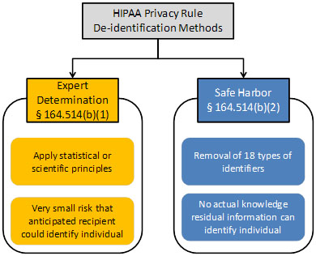
HIPAA-HITECH TRAINING

Slide 21

HIPAA-HITECH TRAINING
De-identification of PHI:
Removal of 18 Specific Identifiers Method
Information is deemed to be de-identified if all of the following identifiers of the individual or of relatives, employers or household members of the individual are removed, and the covered entity does not have actual knowledge that the information could be used alone or in combination with other information to identify an individual who is a subject of the information:
Names
Dates relating to an individual
Telephone, Fax numbers
E-mail addresses
Social Security numbers
Medical record numbers
Health plan beneficiary numbers
Account numbers
Certificate/license numbers
Vehicle identifiers and serial numbers, including license plate numbers
Device identifiers and serial numbers
Web Universal Resource Locators (URLs)
Internet Protocol (IP) addresses
Biometric identifiers, including finger and voice prints
Full-face photographic images and any comparable images
Any other unique identifying number, characteristic or code

Slide 22
HIPAA-HITECH TRAINING
De-identification of PHI:
“Expert Determination” method: A covered entity may determine that health information is not individually identifiable health information only if:
A person with appropriate knowledge of and experience with generally accepted statistical and scientific principles and methods for rendering information not individually identifiable:
Applying such principles and methods, determines that the risk is very small that the information could be used, alone or in combination with other reasonably available information, by an anticipated recipient to identify an individual who is a subject of the information; and
Documents the methods and results of the analysis that justify such determination.

Slide 23

HIPAA-HITECH TRAINING
Submit Questions to your HIPAA Officers
SDM HIPAA Privacy Officer:
Sarah L. Augustynek, JD/MPH
Compliance Officer
716-829-3332
slcouch@buffalo.edu
SDM HIPAA Security Officer:
Gunther Kohn, CIO
716-829-2057
gkohn@buffalo.edu

